Slide 1
CONFERENCE „From a growing to a great city”
KEY FINDINGS AND RESULTS
Rostock, 14 – 17 May 2017
smallships.eu

Slide 2
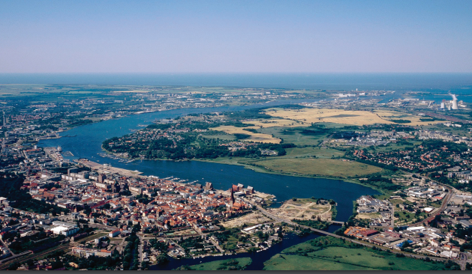
Introduction:
The six teams consisted of the members of the UBC Planning Cities and Smart & Prospering Cities Commissions, as well as the Interreg JOHANN network gathered to elaborate three perspectives for Rostock:
Entire City (macro scale);
Inner City & Old Harbour (mezo scale);
Old Harbour with focus on small cruise liner area (micro scale)
The motto of the conference was: „From a growing city to a great city”.

Slide 3
Introduction:
JOHANN: Joint development of Small Cruise Ship tourism heritage products in the South Baltic
The project aim is to establish the Southern Baltic Sea Region as an attractive small cruise ship (SCS) destination. We have been developing plans for cultural and natural SCS heritage routes to and between six selected destinations: Rostock, Wismar, Stralsund, Kalmar, Karlskrona and Szczecin. The project is going to promote all-round cruise routes and packages for private cruise operators. Further information: http://dev.smallships.eu
Union of the Baltic Cities (UBC)
UBC is the leading network of cities in the Baltic Sea Region with around 100 Member Cities from Denmark, Estonia, Finland, Germany, Latvia, Lithuania, Norway, Poland, Russia and Sweden. Founded in 1991 in Gdańsk, UBC is a voluntary, proactive network mobilizing the shared potential of its member cities. The UBC and its Member Cities work in close cooperation with other partners and participate actively for the implementation of regional strategies, notably the European Union Strategy for the Baltic Sea Region EUSBSR. Further information: http://www.ubc.net/

Slide 4
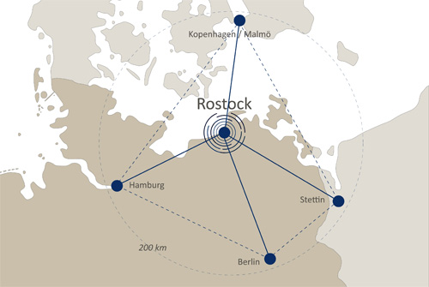
Introduction:
ROSTOCK
Hanseatic city and a seaside resort;
Port-city;
No. 1 centre of commerce in north-east Germany;
the gateway to the Baltic Sea area - one of Europe's economically aspiring regions. This is where the strategic axes of Copenhagen-Berlin and Hamburg-Szczecin cross.

Slide 5
Introduction:
8 Guidelines:
City of science and research
Port city and business centre
City of tourism
Rostock is a trailblazer in climate protection
City of education, culture and sport
Social City
Hanseatic city and seaside resort – commitment to the building culture
Green city by the sea
Details: http://rathaus.rostock.de/sixcms/media.php/1068/rostock2025_engl4.pdf

Slide 6
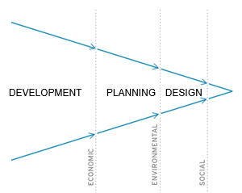
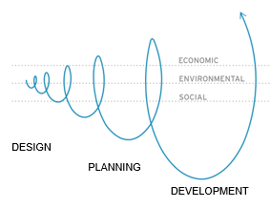
From a growing to a great city
„There is no longer a single city model but cities do have common features and face common challenges. Cities compete on the same scarce resources, talens and creative class. The Systemic Thinking and multistakeholder’s approach is needed to create city’s value” - Michel Sudarskis (Secretary General INTA – International Urban Development Association)

Slide 7
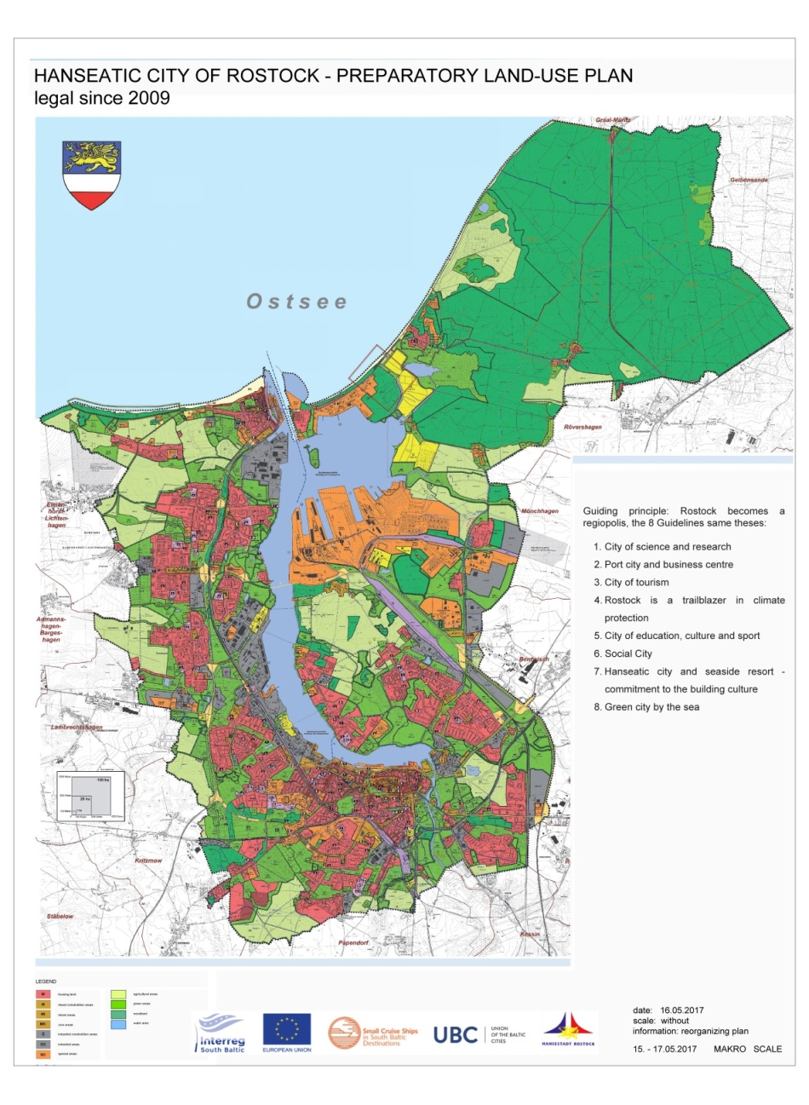
MACRO SCALE - ECONOMY
Target groups:
Investors & developers
Talents & creative class
Tourists
Small cruise shipowners
Citizens
Strategic stakeholders:
Toursit & Maritime Clusters
Business (SME)
City councils
Universities
NGOs & social movements

Slide 8
MACRO SCALE - ECONOMY
Recommendations:
Think big – develop a synergy of interests between South Baltic cities and regions for target groups attraction;
Act small – make the inner city, the harbour area and Rostock in general more attractive for youth and families – normal income groups; – expand the university and business cooperation; – involve the citizens/ users in making the change;

Slide 9
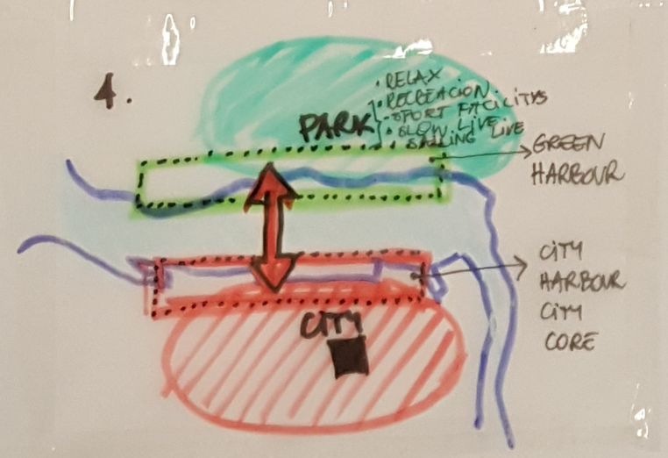
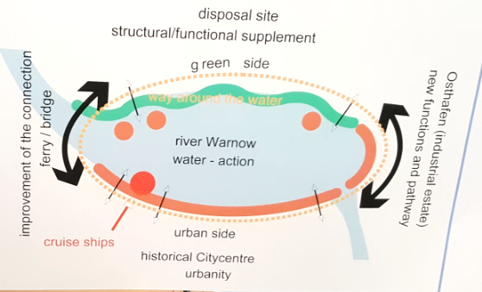
MACRO SCALE – URBAN PLANNING
Recommendations:
Two parts = Two offers
Extend core city to Eastern side;
Western side – Inner City (historical & business);
Eastern side – Slow & Garden City (local craftship & tourist);
Rostocker Oval
Pedestrian bridge over Warnow river

Slide 10
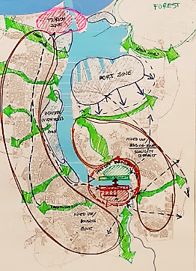
MACRO SCALE – URBAN PLANNING
Recommendations:
Lack of architectural „Icon” building for Rostock;
Save urban structure of Rostock (green belts);
Make Rostock attractive for the whole year (especially a beating heart of Inner City waterfront)
Promote Rostock as „Cluster Life City” (perfect for Life, Work and Leisure);
Create new waterfront at the Eastern side and rebuild the Western side. Keep them public & open.

Slide 11
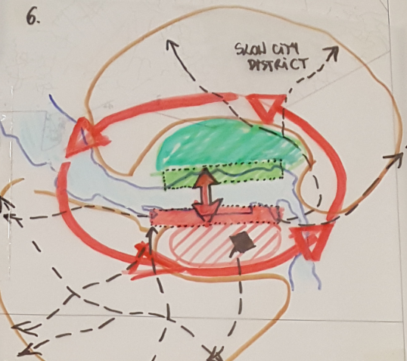
MESO SCALE – RECOMENDATIONS FOR INNER CITY:
Integrate the harbour area with the Inner City – consider a river public transport system;
Improve connectons on Am Strande – dig a tunel, build pedestrian bridge over Warnow river, lower the speed of the traffic, better bicycle lanes, integrate pedestrian accesss to the waterfront/ old harbour with existing roads, less parking spaces in the old harbour – hide them underground;
Make the harbour area a liveable place – 24/7/365 for all Rostockers and guests;
Share costs with the all stakeholders;
Consult needs and barriers with the all stakeholders;

Slide 12
MESO SCALE – RECOMENDATIONS FOR INNER CITY:
Find a systemic solution to combine interests of Eastern residential communities and Western night life in public debate;
Build the world’s most flexible culture house for the museum or theatre – make them spaces for creative sector, start-ups, local initatives, local artists, craftsman;
Go on with Hansa Sail but do not make new and old waterfront development dependent on it;
Find the closest embarkment for small cruise ships near the Old Harbour and do not agree to surround them with fences – think about slow city hotels & restaurants on Eastern side and attractions connected with locality (craft, food, history);

Slide 13
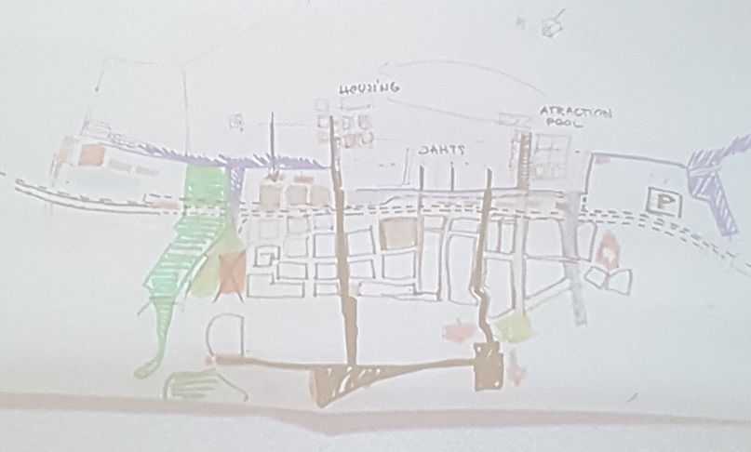
MICRO SCALE – RECOMENDATIONS FOR INNER CITY:
„When the water flow, then the life will flow too” – Rostock is a Hanseatic City: most imporant streets go to the river but there are trafiic barriers, that limit city’s access to water – consider to make a channel into Inner City;
Enhance industrial heritage of Rostock – present it as frontrunner of architecture (waterfront houses from 80’s, old port facility as monuments);
Make river & port present in the perception of citizens;
Create public & open spaces in waterfront – attractive and iconic landscape.

Slide 14
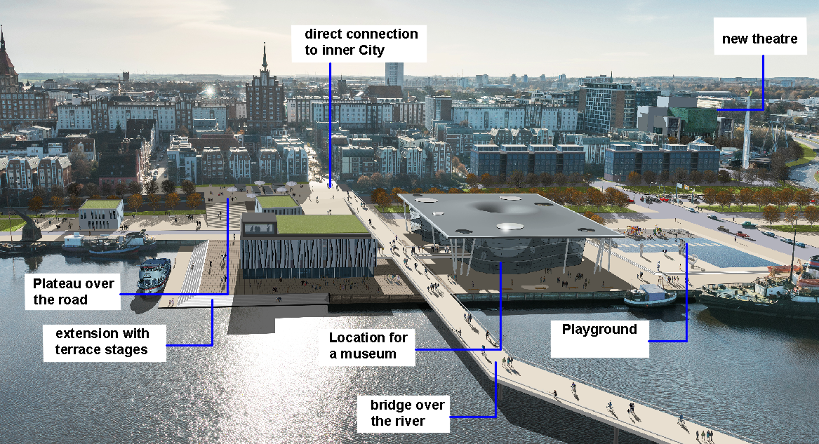
MICRO SCALE – RECOMENDATIONS FOR INNER CITY:

Slide 15
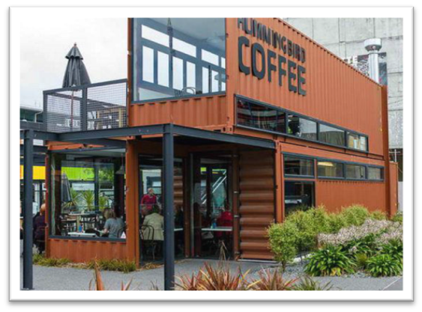
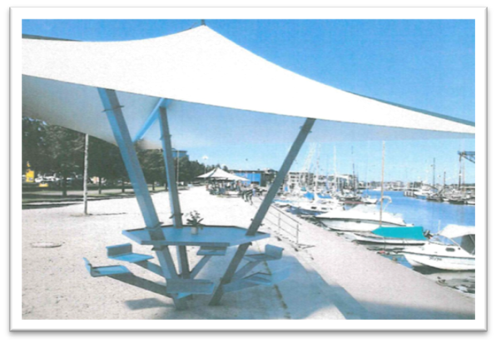
some suggested measures for short-term revitalization of city harbour
example for container modules for temporary uses in the area “Christinenhafen”
establishment of resting places
temporary sport field (e.g. for Beachvolleyball, Streetball or Streetsoccer)

